Slide 1
Amazon Sales Detailed Report
By : Mithun M M

Slide 2
Overview
The sales data provided covers transactions from various regions, product types, sales channels, and Order Priority. The analysis aims to uncover insights to guide decision-making and improve future sales performance.

Slide 3
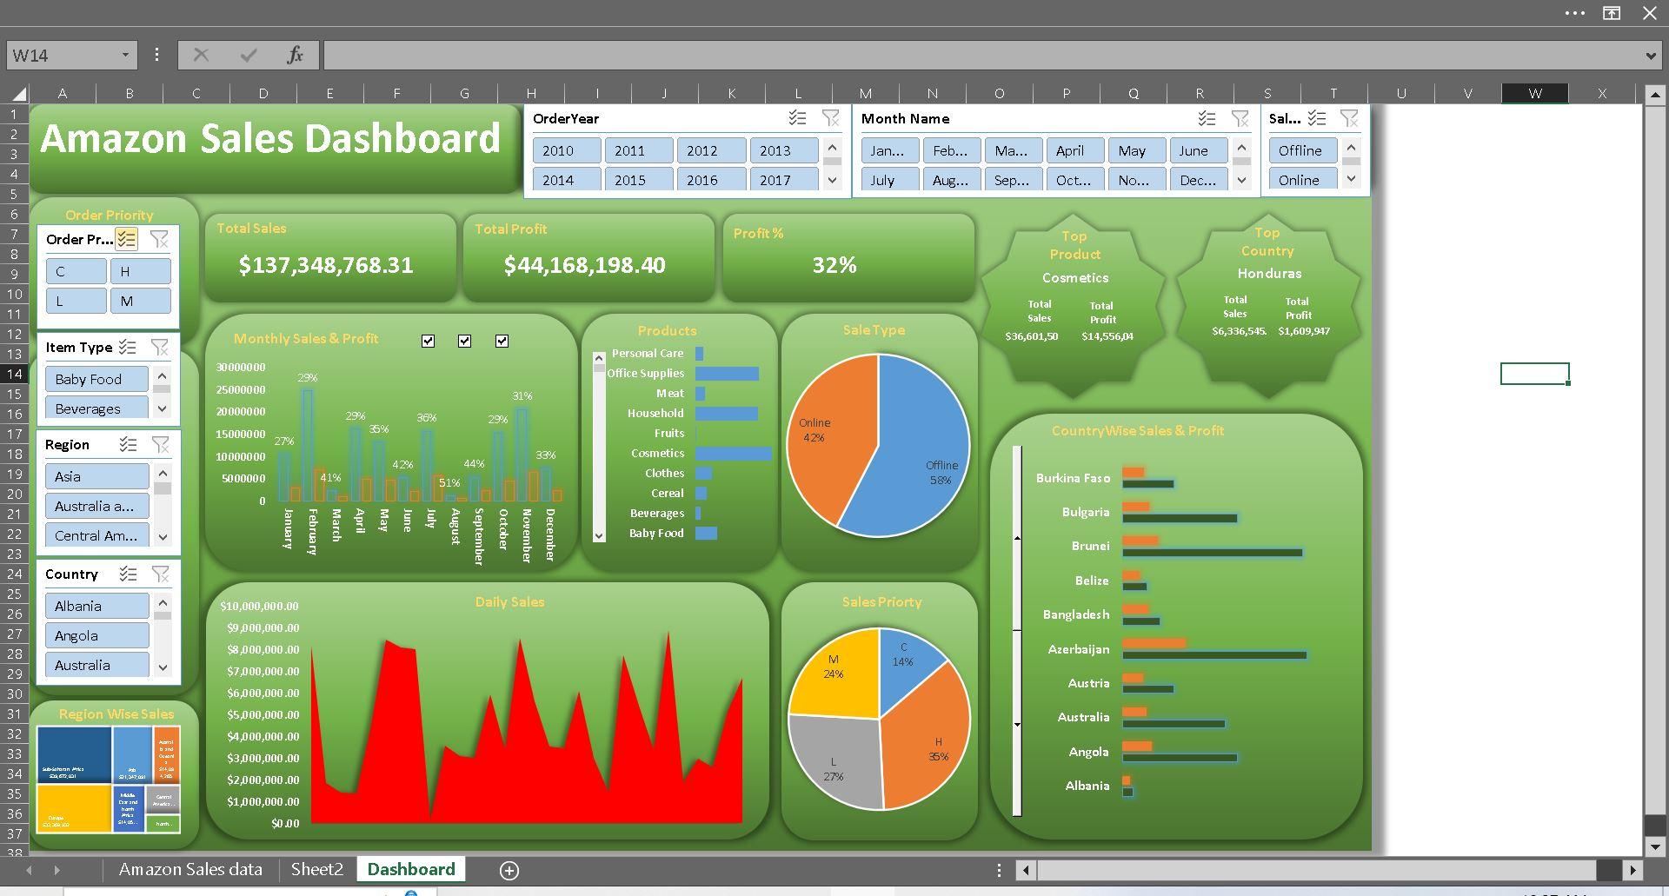
Amazon Sales Data Dashboard

Slide 4
Recommendations
Based on the analysis, the following recommendations are proposed to improve future sales performance:
Capitalize on seasonal trends by adjusting marketing efforts and inventory levels accordingly.
Allocate resources towards promoting top-performing products and optimizing their availability.
Explore opportunities to expand market reach in regions with lower sales through targeted marketing campaigns or partnerships.
Personalize marketing strategies and product offerings to different customer segments to enhance engagement and satisfaction.

Slide 5
Thank You

